Slide 1
Unit 4 1. Networking

Slide 2
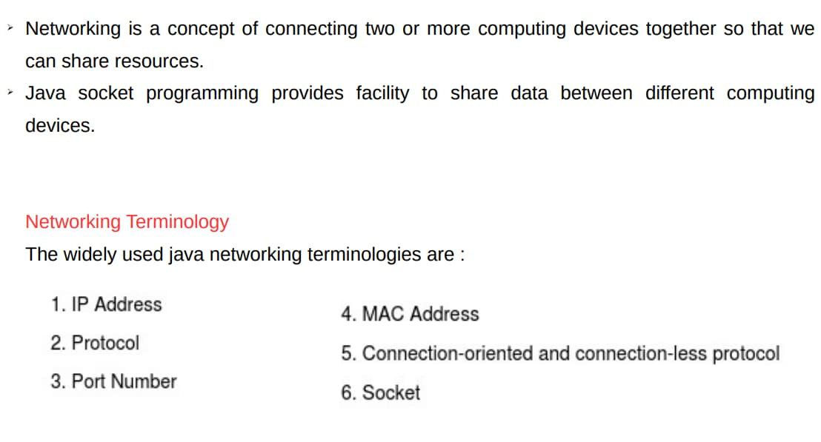
Networking Basics

Slide 3
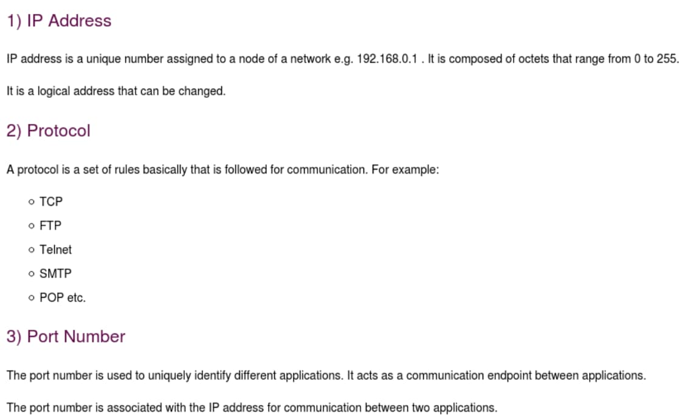
Networking Basics

Slide 4
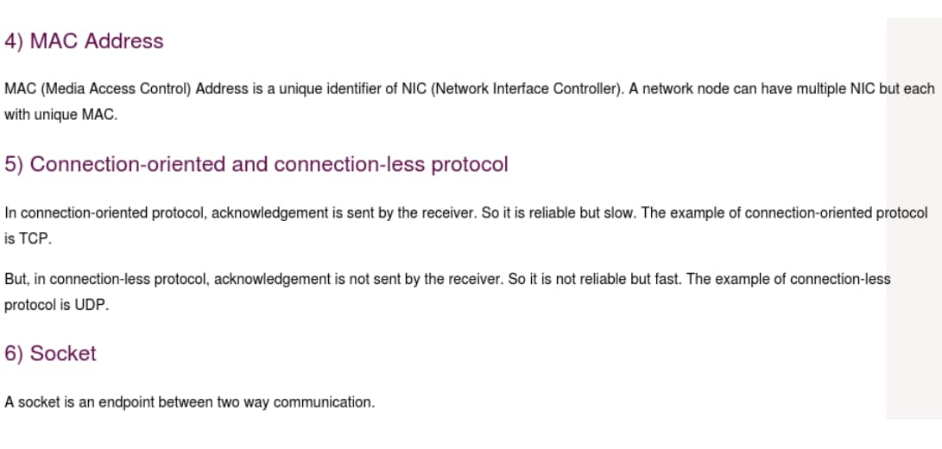
Networking Basics

Slide 5
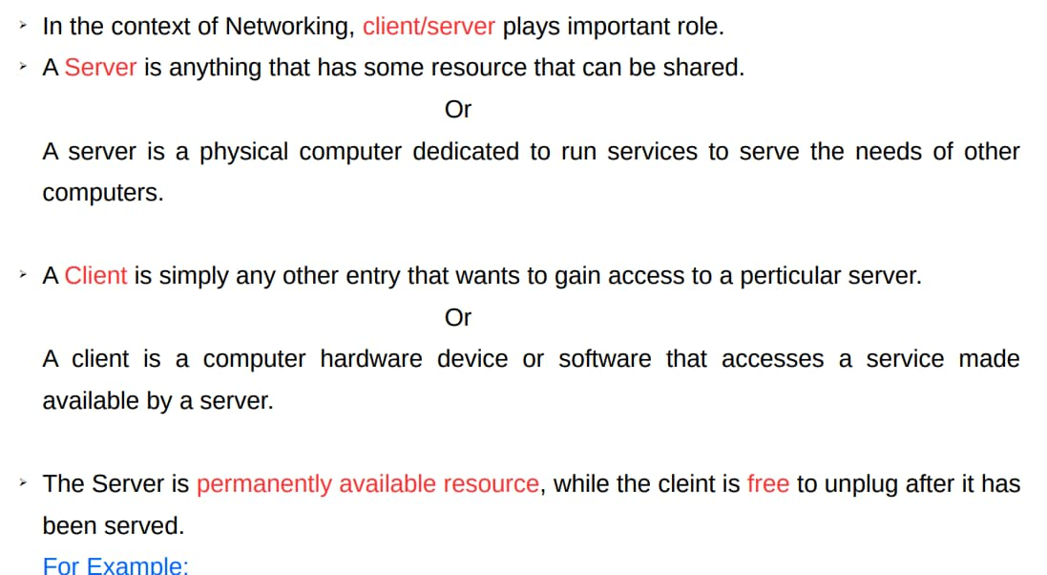
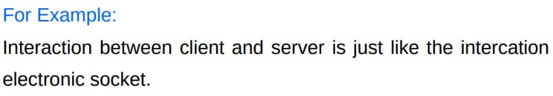
Networking Basics
between a lamp and an

Slide 6
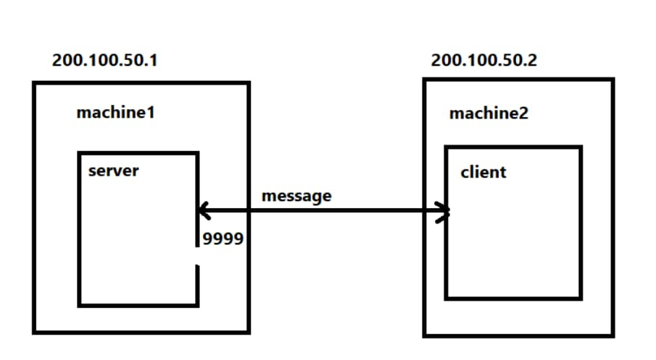
Networking Basics

Slide 7
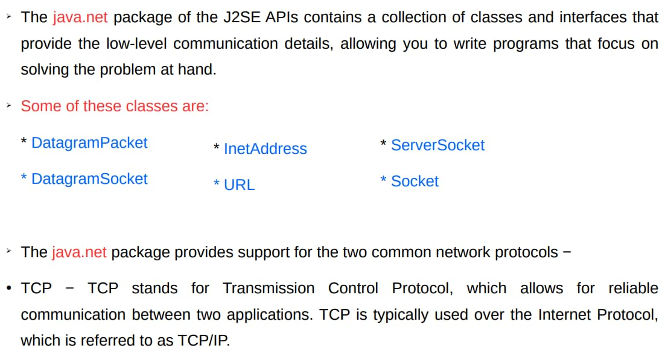

Java and the net
protocol that allows for

Slide 8
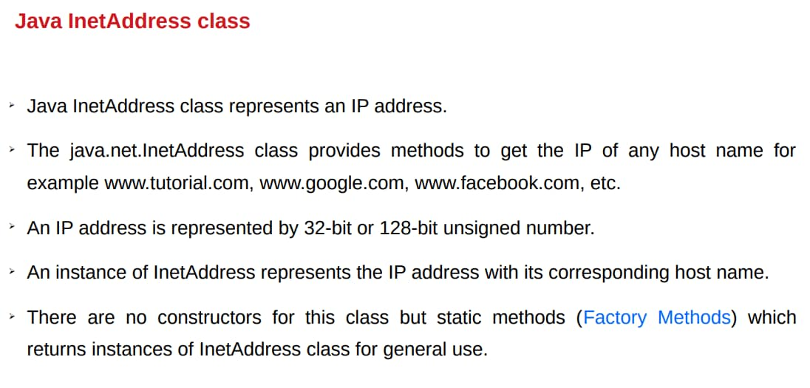
The Networking Classes and Interfaces

Slide 9
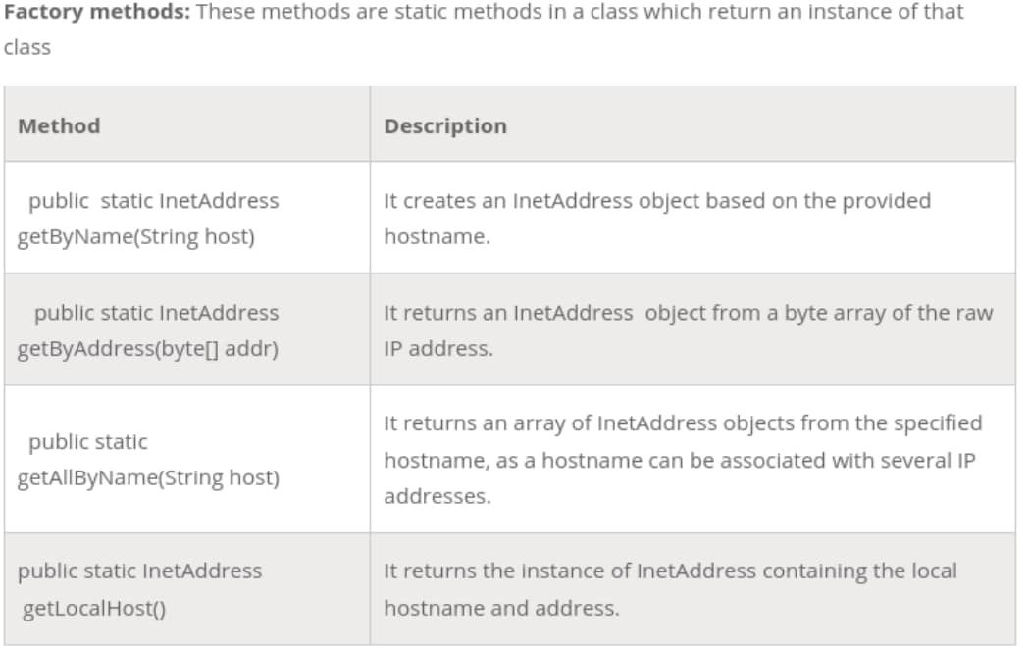
Java InetAddress class
conditions.

Slide 10
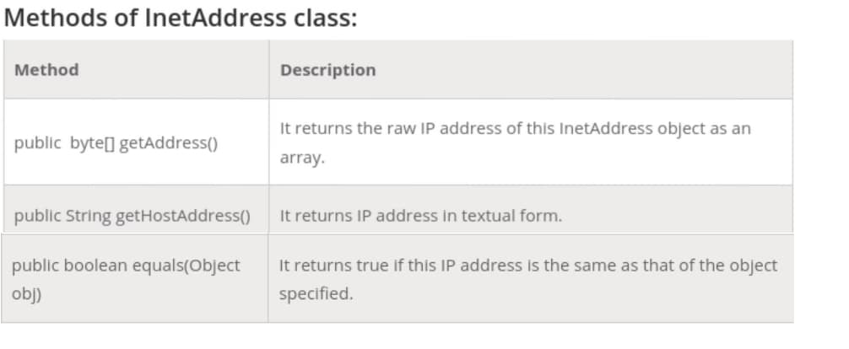
Java InetAddress class

Slide 11
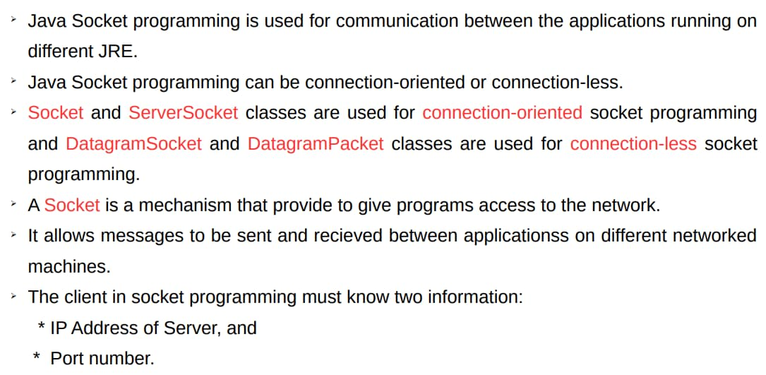
Socket Programming

Slide 12
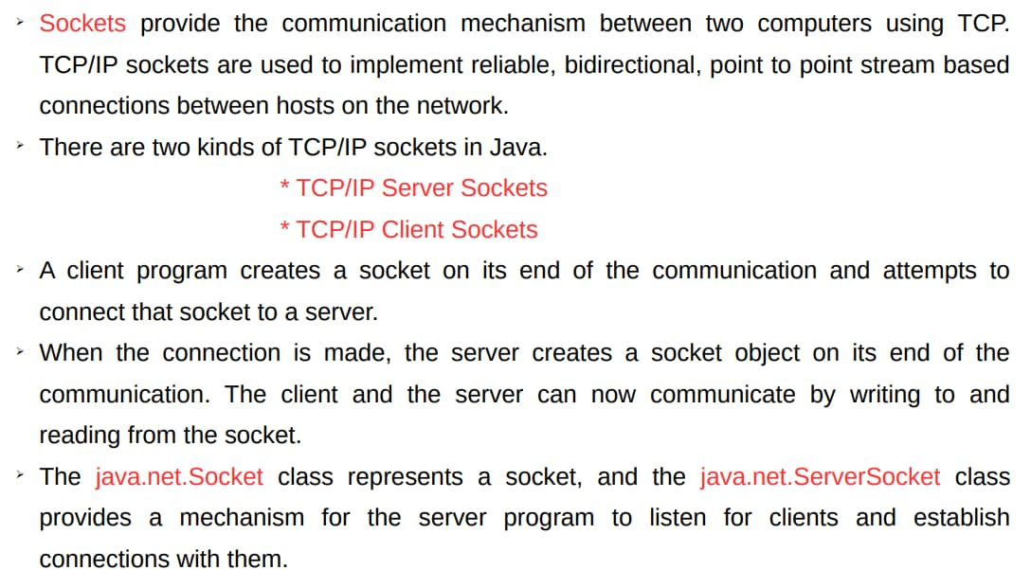
TCP/IP Sockets
the client to connect

Slide 13
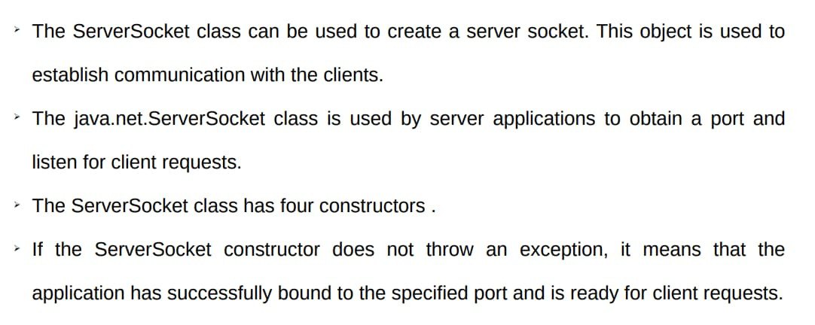
TCP/IP Server Sockets

Slide 14
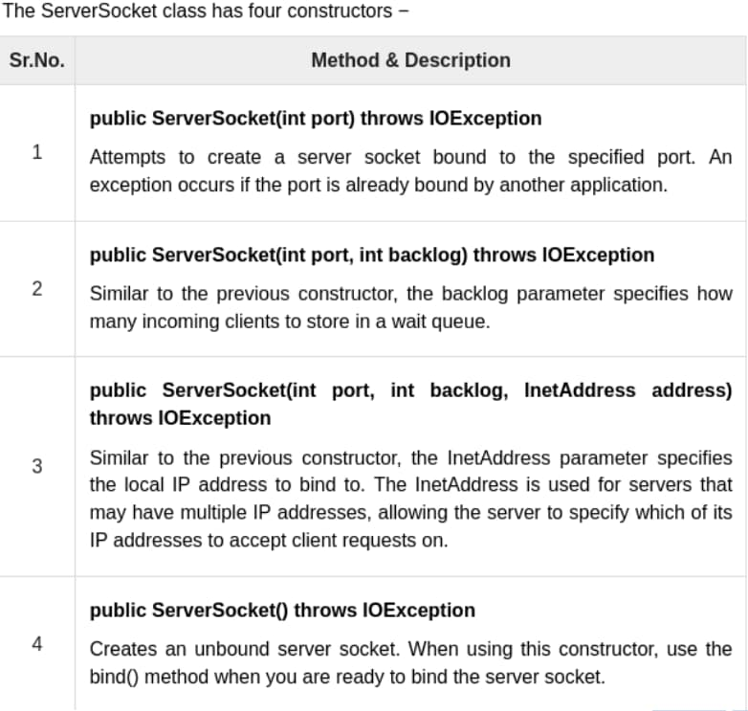
TCP/IP Server Sockets

Slide 15
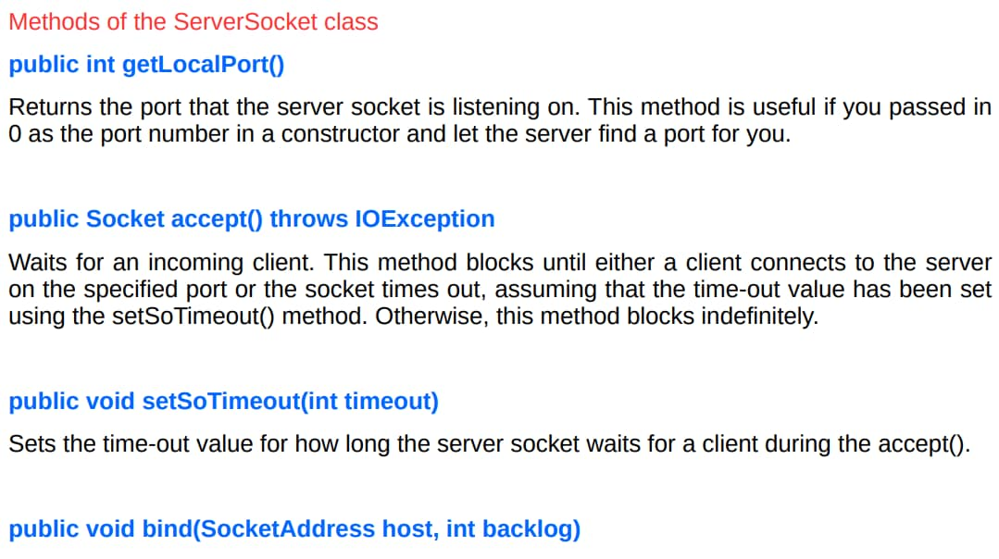

TCP/IP Server Sockets
SocketAddress object. Use this
no-argument constructor.

Slide 16
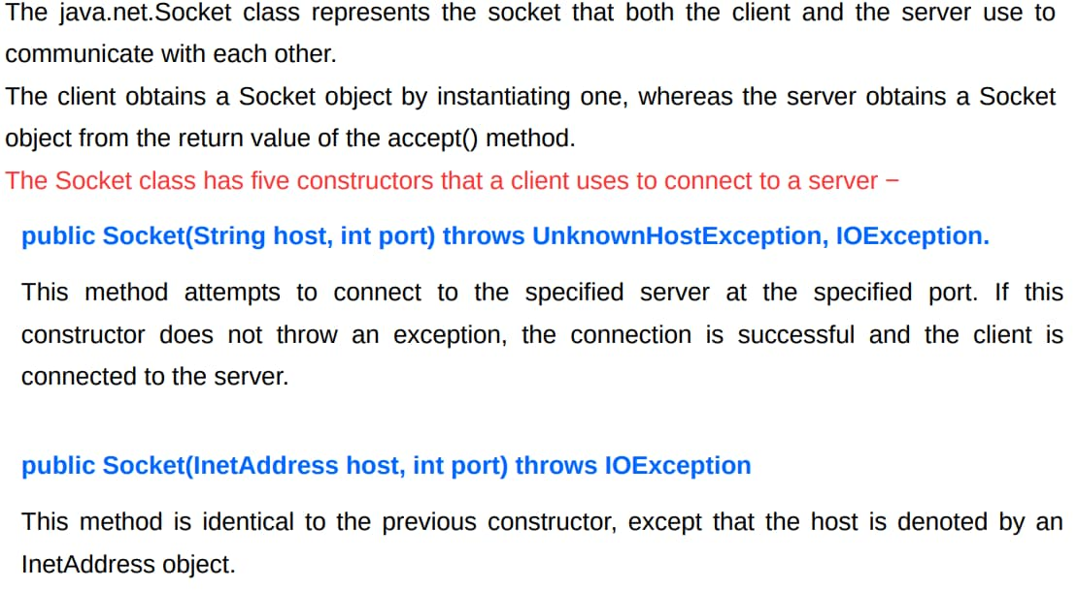
TCP/IP Client Sockets

Slide 17
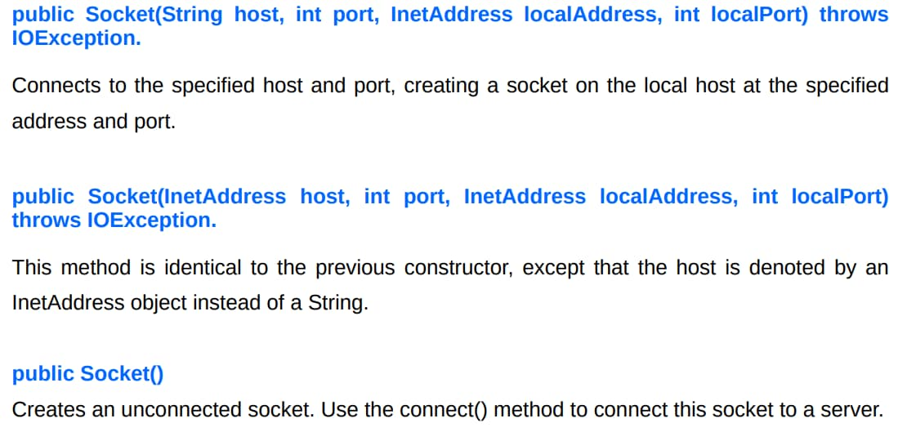
TCP/IP Client Sockets

Slide 18
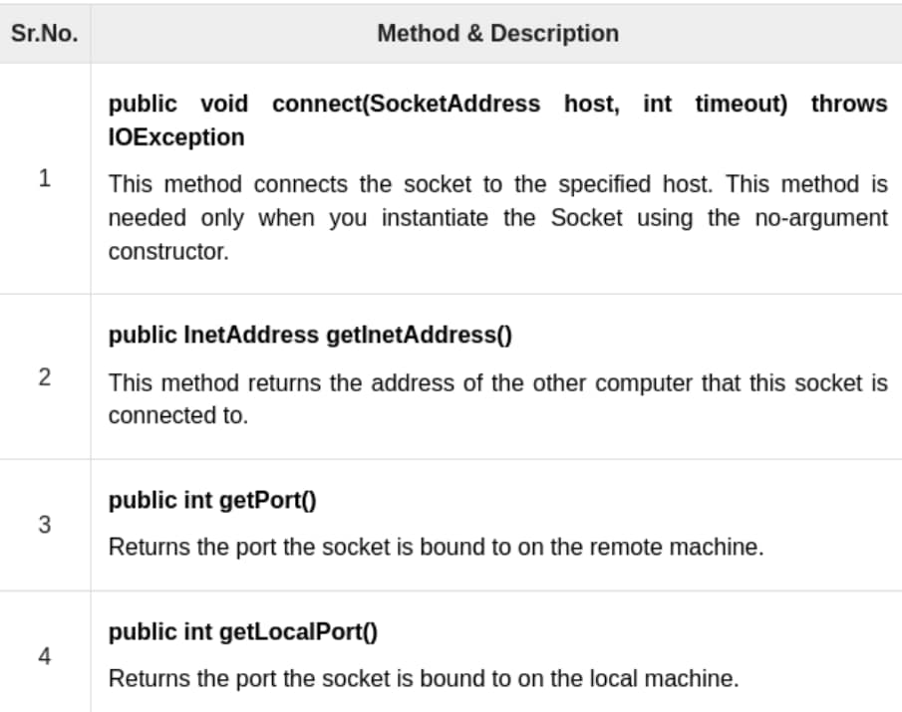
TCP/IP Client Sockets

Slide 19
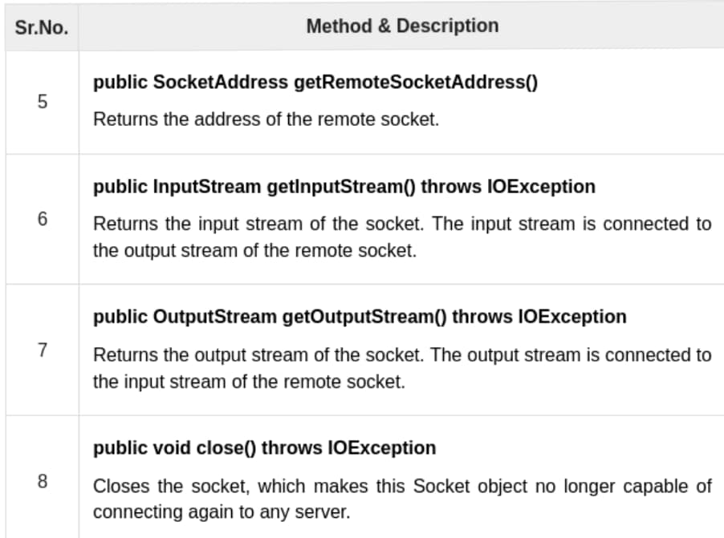
TCP/IP Client Sockets

Slide 20
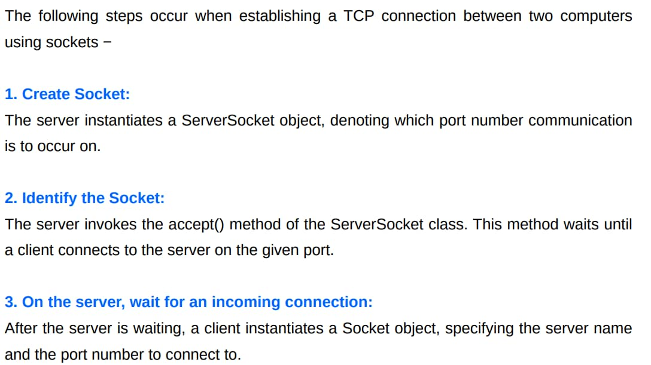
TCP/IP Sockets

Slide 21
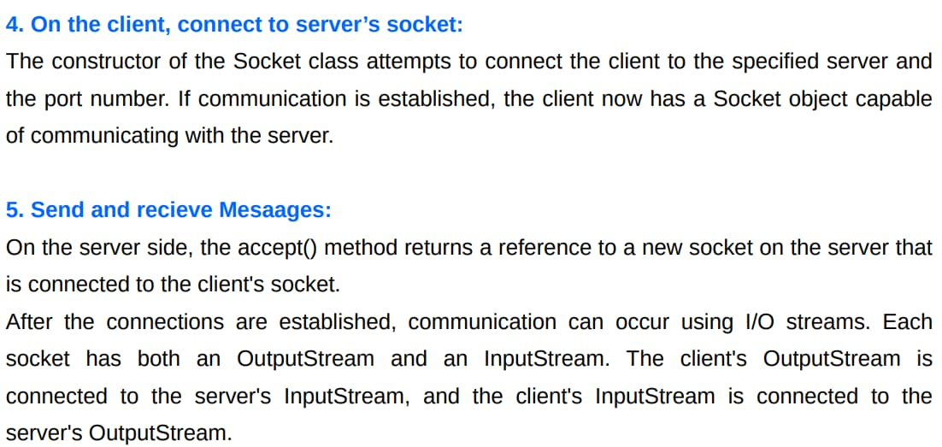
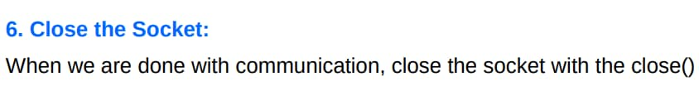
TCP/IP Sockets
system call.

Slide 22
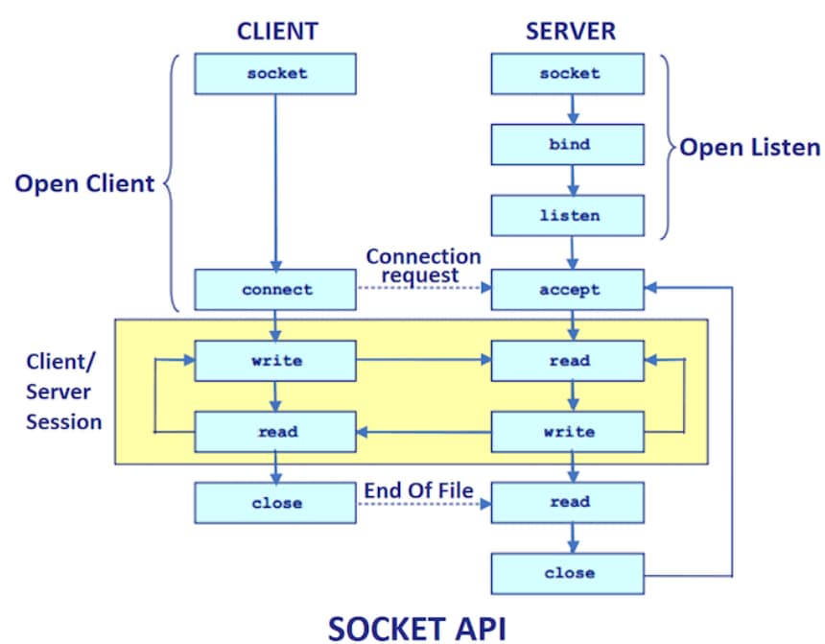
TCP/IP Sockets

Slide 23
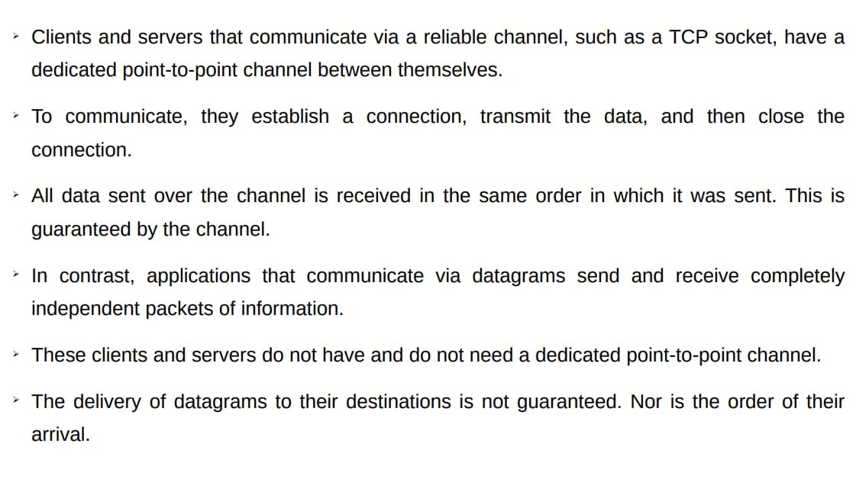
Datagrams

Slide 24
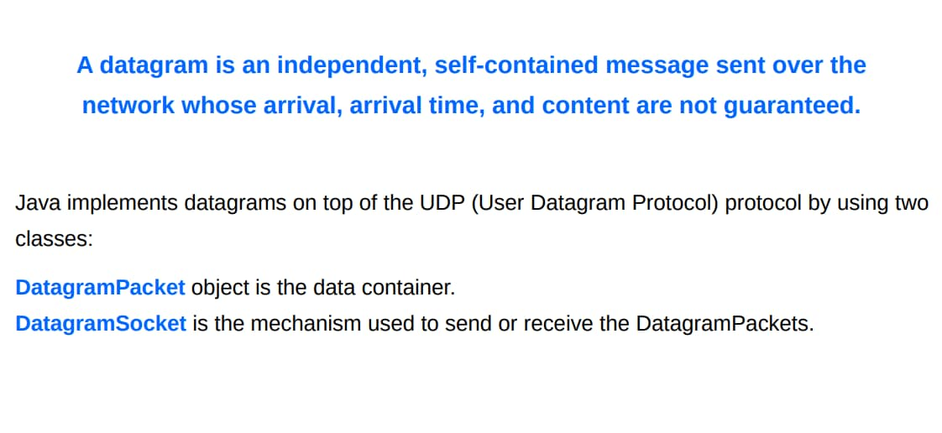
Datagrams

Slide 25
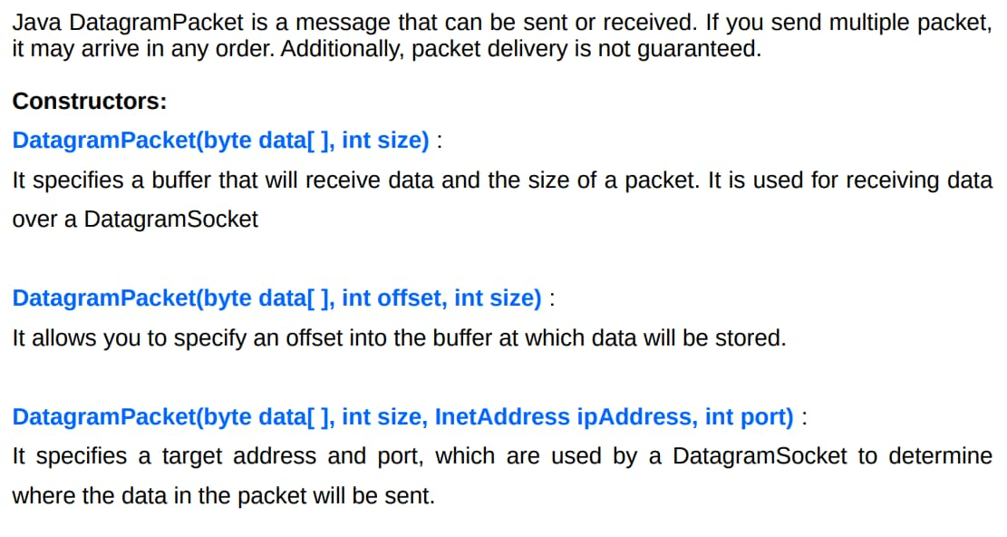

Datagrams Packets
ipAddress, int port) :

Slide 26
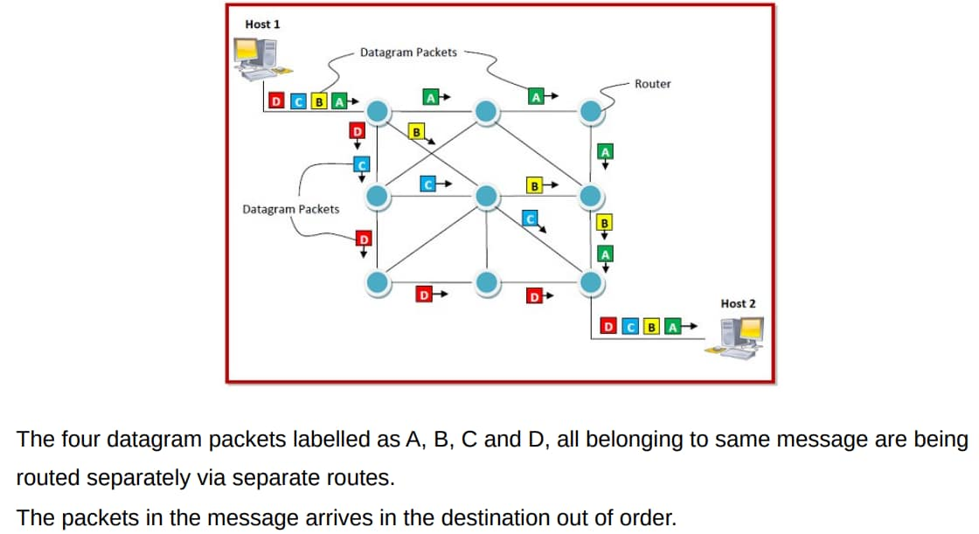
Datagrams Packet class
original message.

Slide 27
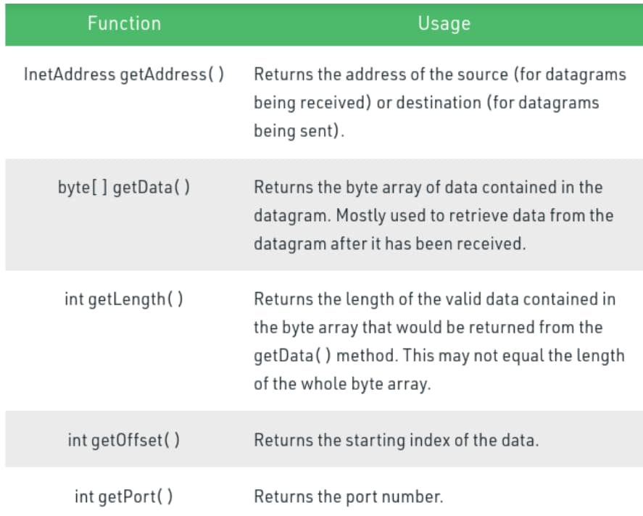
Datagrams Packet class Methods

Slide 28
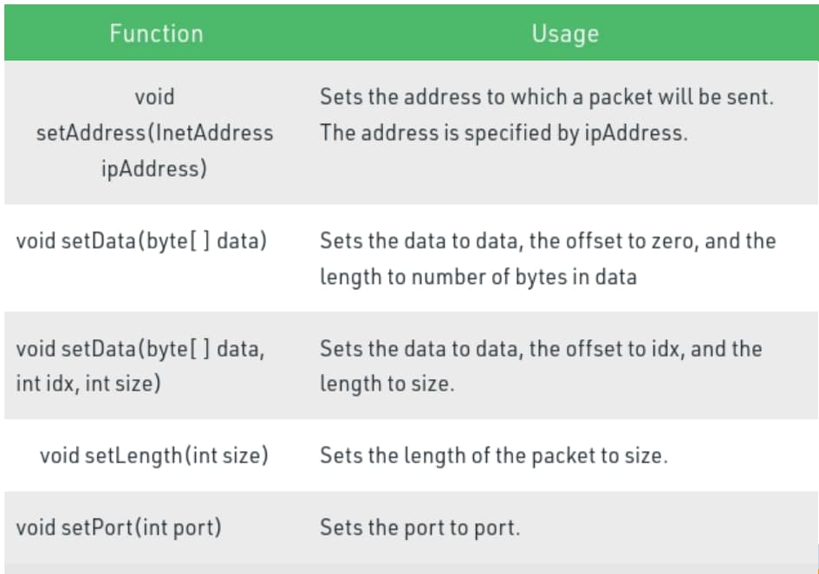
Datagrams Packet class Methods

Slide 29
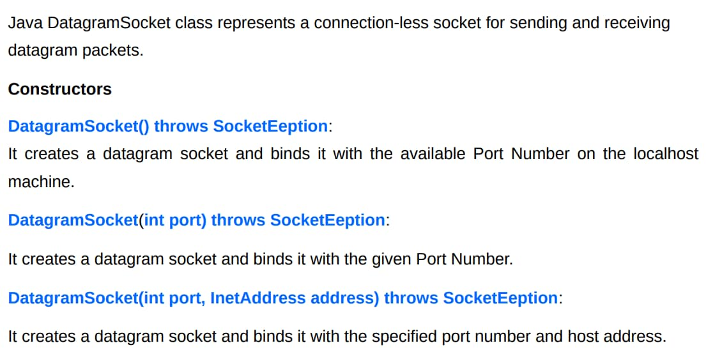
Datagrams Sockets

Slide 30
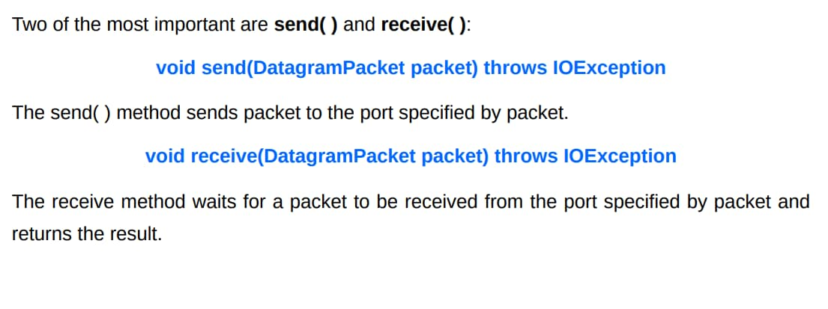
Datagrams Sockets

Slide 31
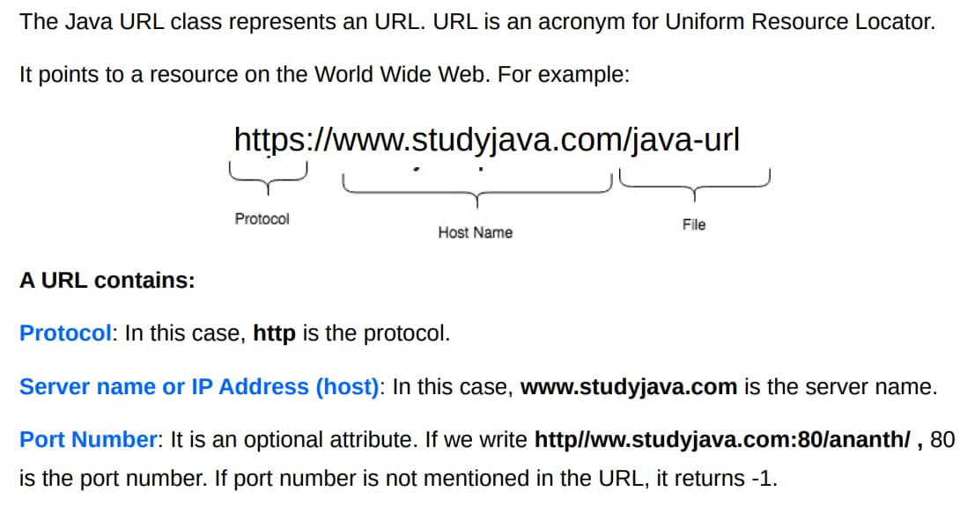
Java URL
(Default port number For http:80, ftp:21, finger:79, https:443)

Slide 32
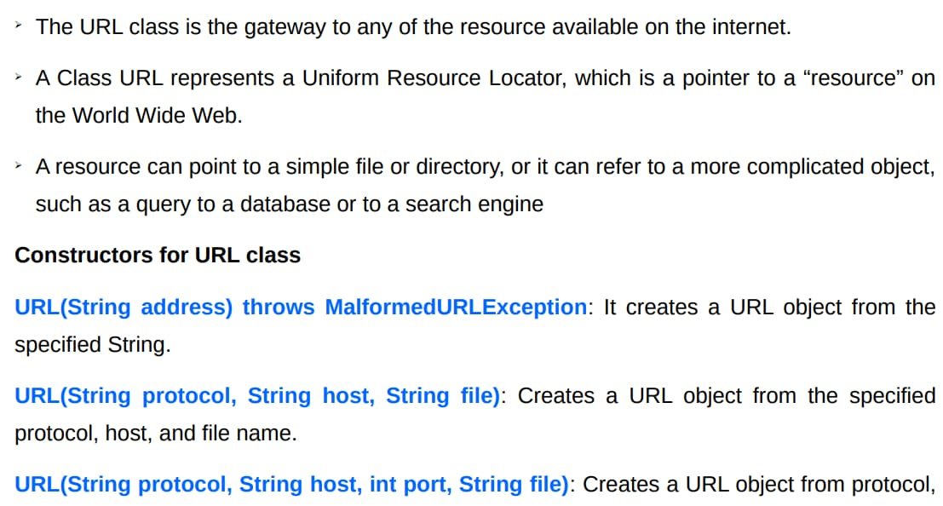
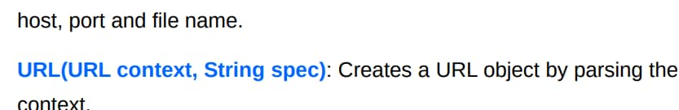

Java URL class
given spec in the given

Slide 33
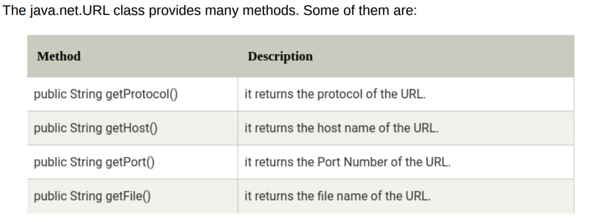
Java URL class

Slide 34
Unit 4 2. RMI

Slide 35
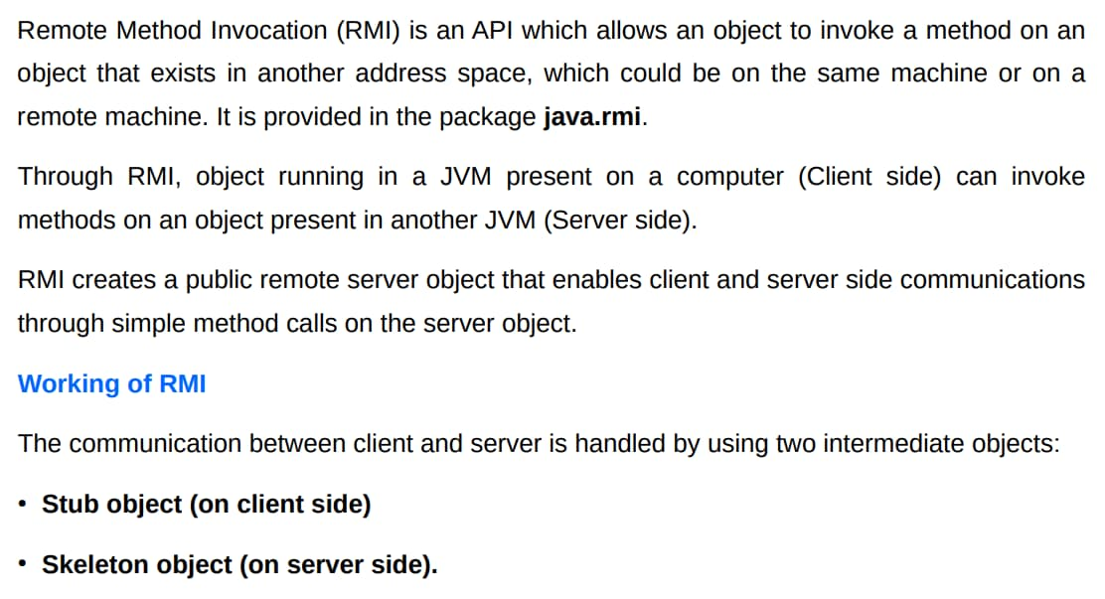
RMI (Remote Method Invocation)

Slide 36
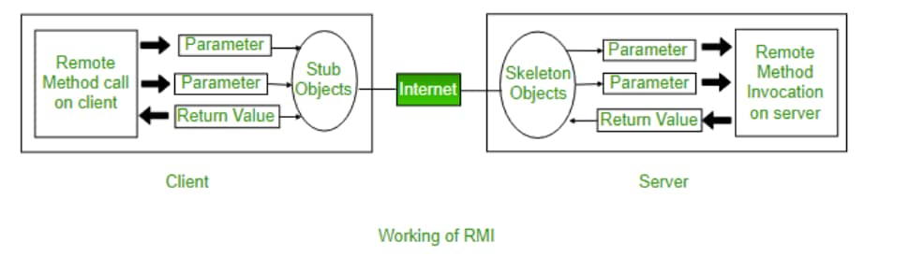
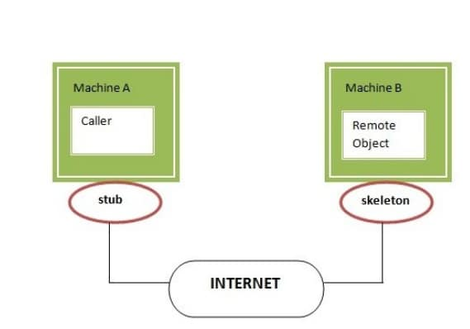
Working of RMI

Slide 37
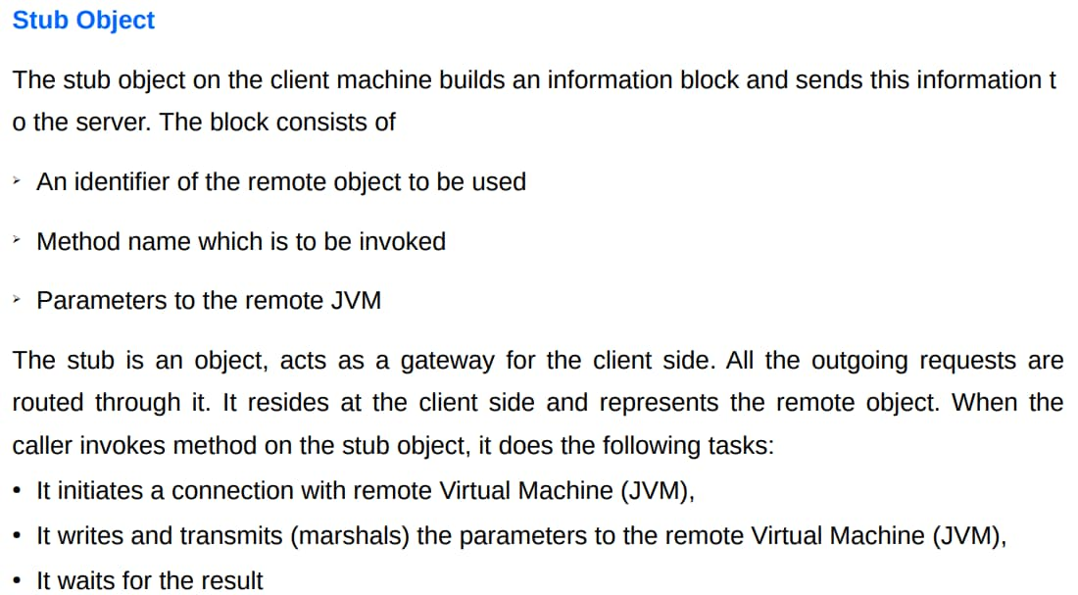
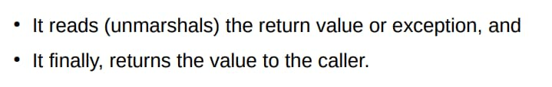
Working of RMI

Slide 38
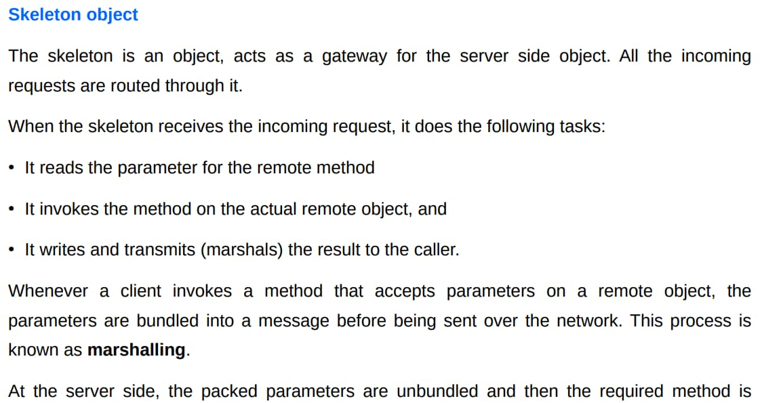
Working of RMI

Slide 39
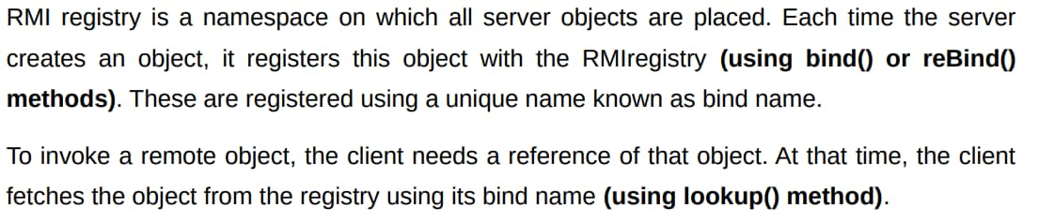
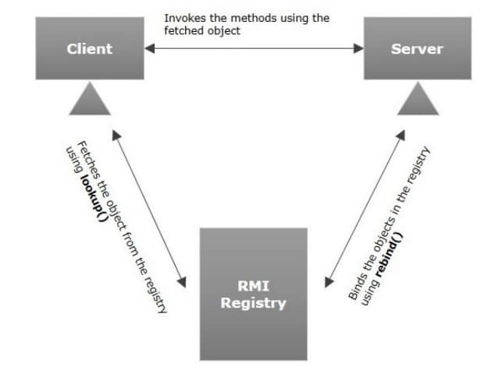
Working of RMI
RMI Registry

Slide 40
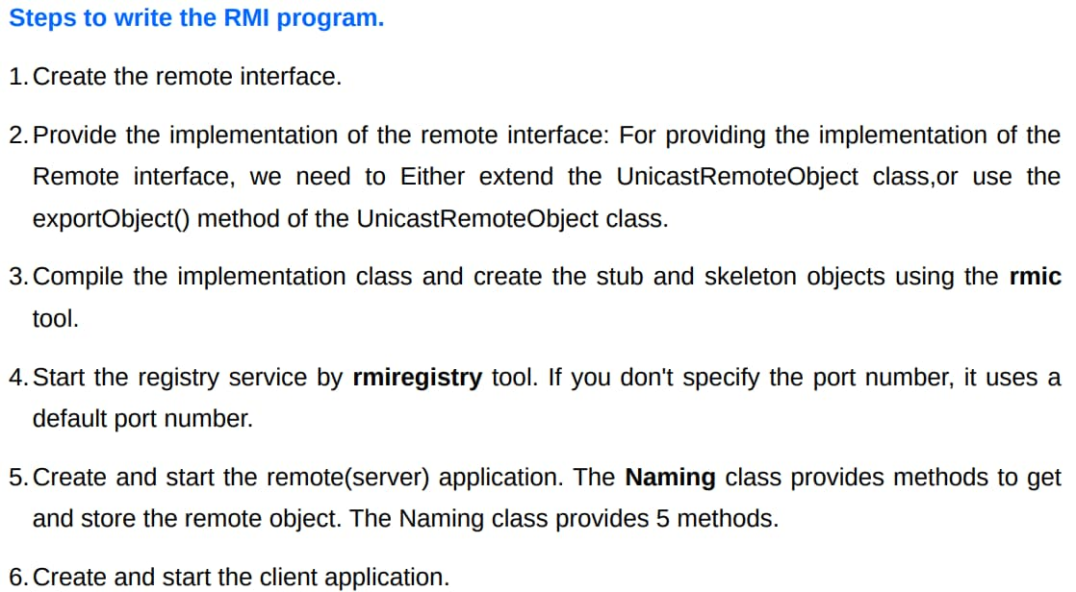
Working of RMI

Slide 41
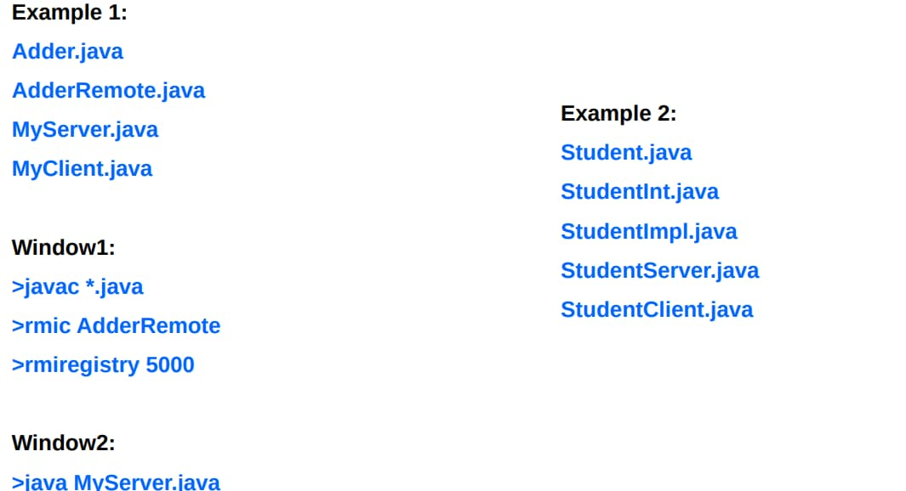
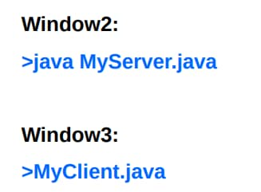
Working of RMI

Slide 42
Unit 4 3. JDBC

Slide 43
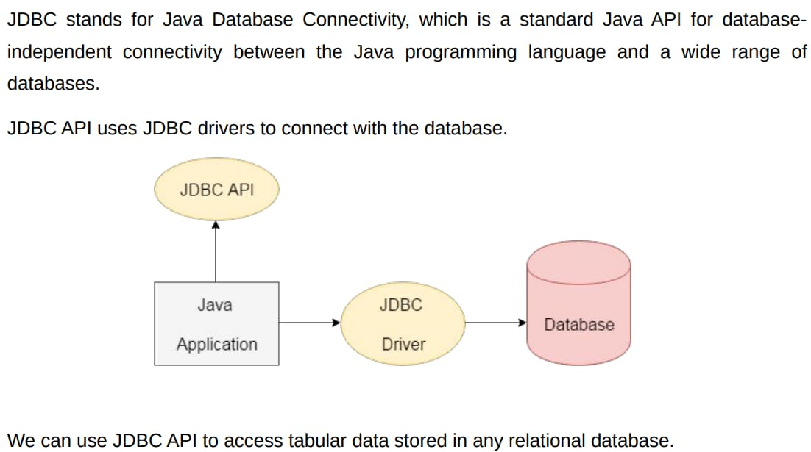
Java JDBC
from the database.

Slide 44
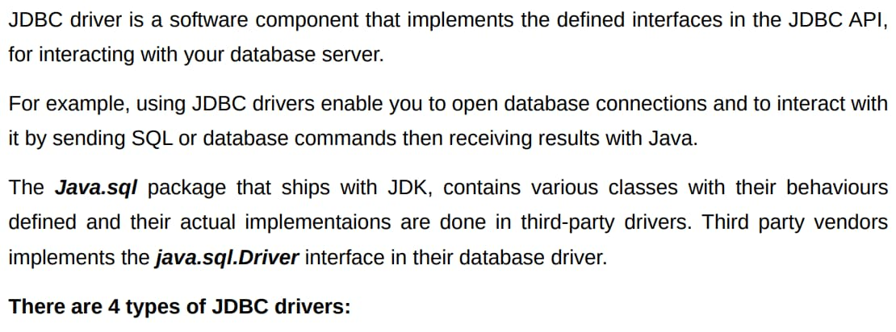
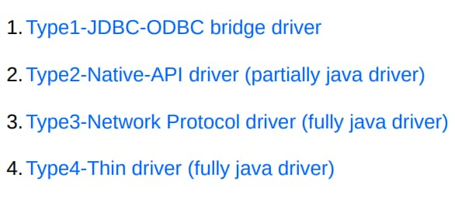
JDBC Drivers

Slide 45
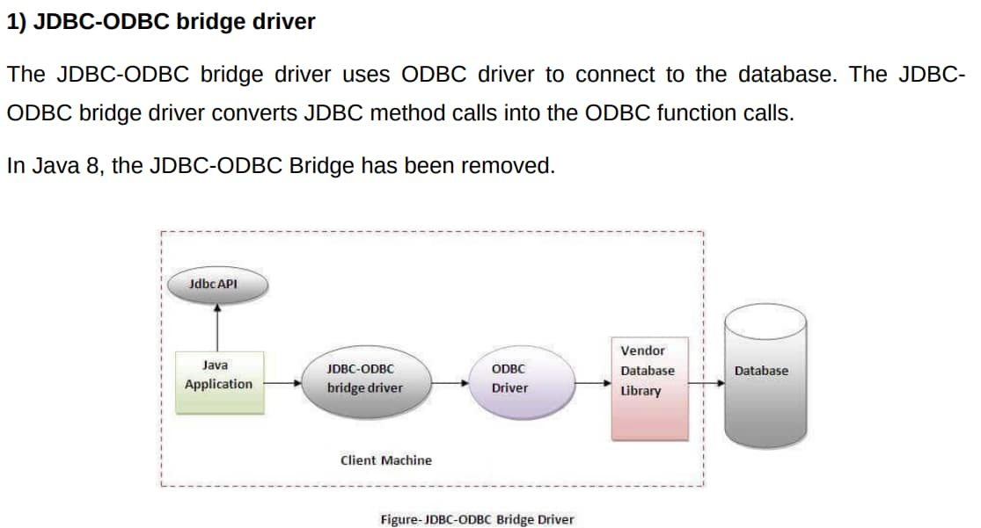
JDBC Drivers

Slide 46

JDBC Drivers

Slide 47

JDBC Drivers

Slide 48

JDBC Drivers

Slide 49

JDBC Drivers

Slide 50

JDBC Drivers

Slide 51

JDBC Drivers

Slide 52

JDBC Drivers

Slide 53


JDBC Drivers
is typically used for

Slide 54


JDBC Process

Slide 55

JDBC Process - DriverManager

Slide 56

JDBC Process – Connection Object

Slide 57

JDBC Process – Statement Object

Slide 58

JDBC Process – Statement Object

Slide 59

Statement Methods

Slide 60

Prepared Statement

Slide 61

Prepared Statement Methods

Slide 62

Callable Statement

Slide 63

StoredProcedure

Slide 64


Callable Statement Methods

Slide 65

JDBC Process – Resultset Object

Slide 66

Scrollable and Updatable Resultset

Slide 67

Scrollable and Updatable Resultset

Slide 68

Scrollable Resultset

Slide 69

Updateable Resultset

Slide 70


JDBC Process – Accessing Data in Resultset

Slide 71
Unit 4 4.Java Beans

Slide 72


JavaBean

Slide 73


JavaBean - Setter and Getter Methods in Java
either “get” or “is”. But

Slide 74

Example of JavaBean Class

Slide 75

Example of JavaBean Class

Slide 76

JavaBean Properties

Slide 77

JavaBean Properties

Slide 78

Advantages & Disadvantages of JavaBean

Slide 79


JavaBean Introspection

Slide 80

JavaBean Introspection

Slide 81

JavaBean Introspection

Slide 82

JavaBean JAR file

Slide 83


JavaBean JAR file
classpath and then

